Slide 1



MythraGen: Two-Stage Retrieval Augmented Art
Generation Framework​
Quang-Khai Le^{1,2}, Cong-Long Nguyen^{1,2} and Trung-Nghia Le^{1,2}​
¹ University of Science, VNU-HCM, Vietnam
² Vietnam National University, Ho Chi Minh City Vietnam
Notes:
Hello, everyone. My name is Quang-Khai Le. Today, I’m presenting MythraGen: A Two-Stage Retrieval Augmented Art Generation Framework with co-authored by Cong-Long Nguyen and Trung-Nghia Le. This framework represents a significant advancement in the field of text-to-artistic image generation.

Slide 2
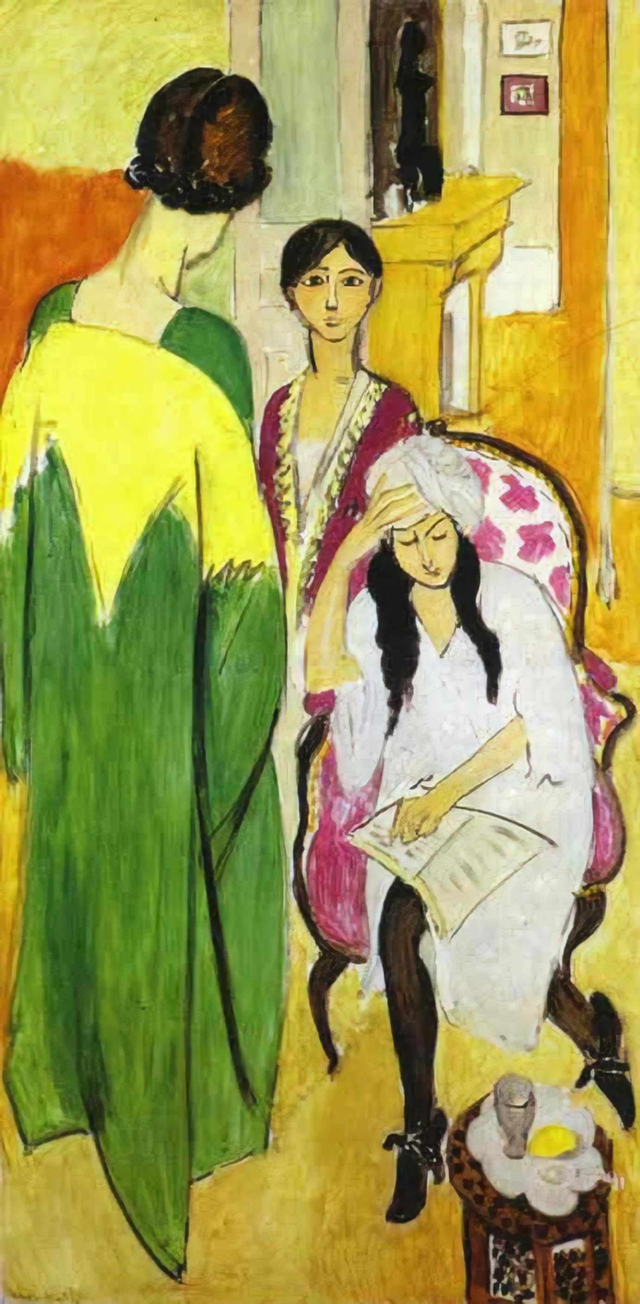
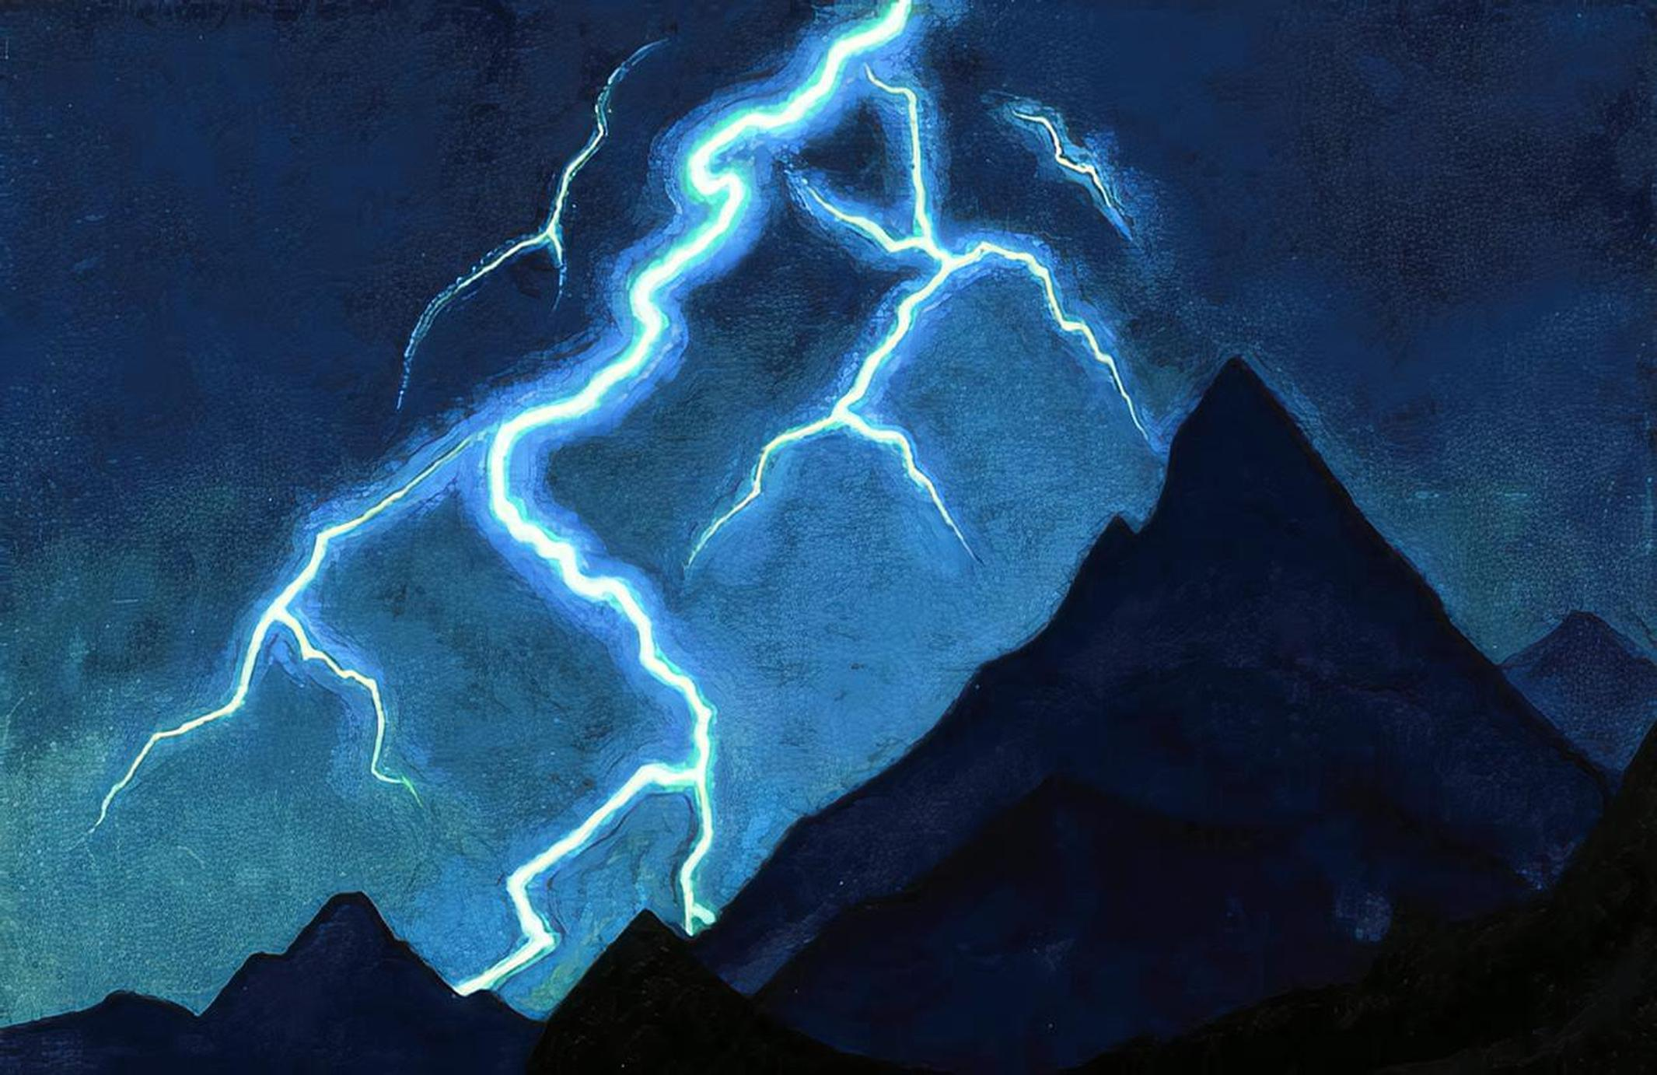
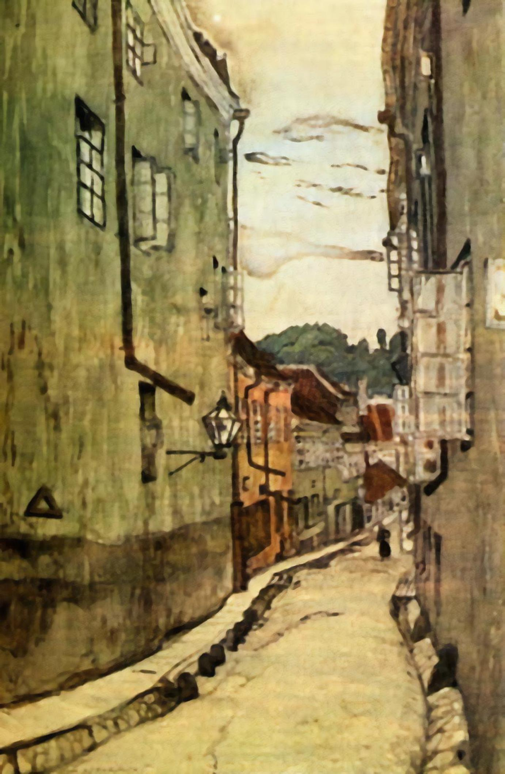
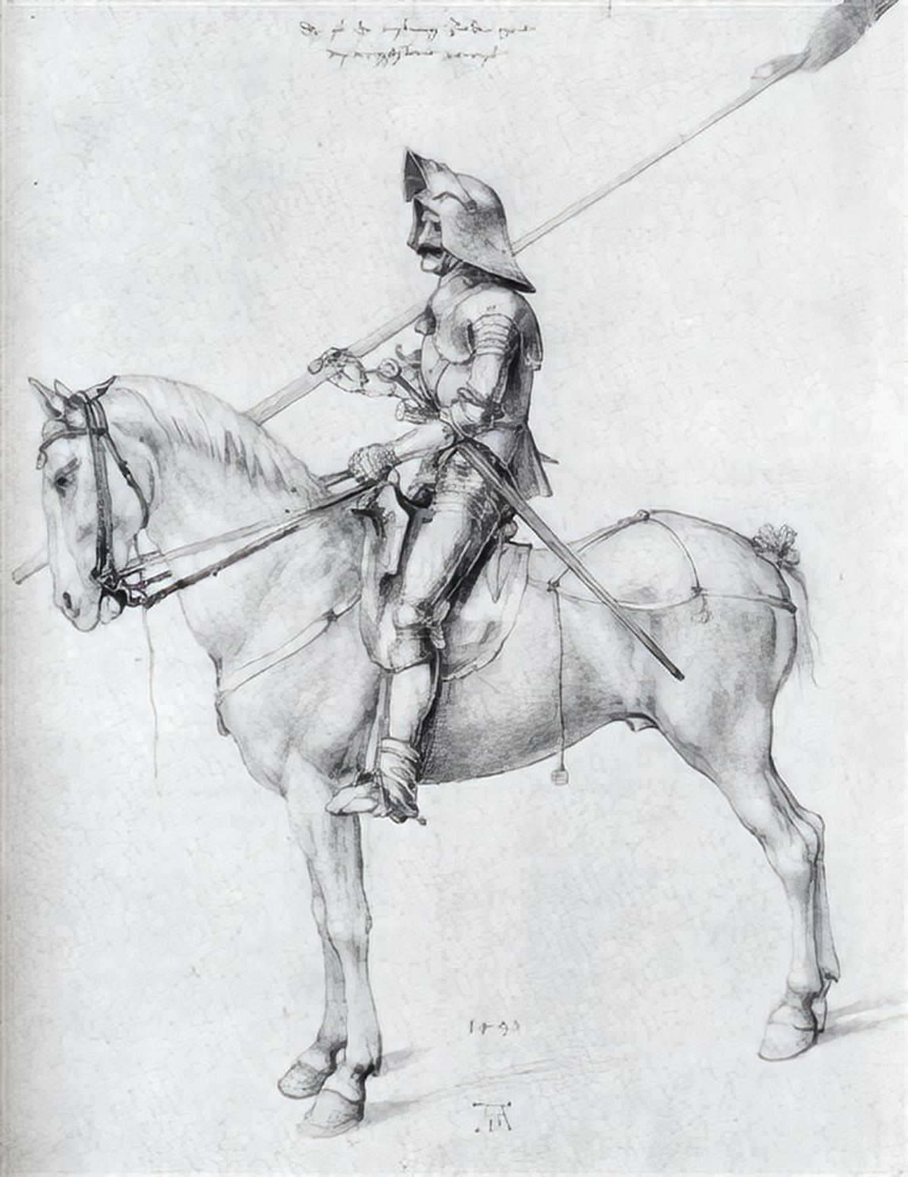
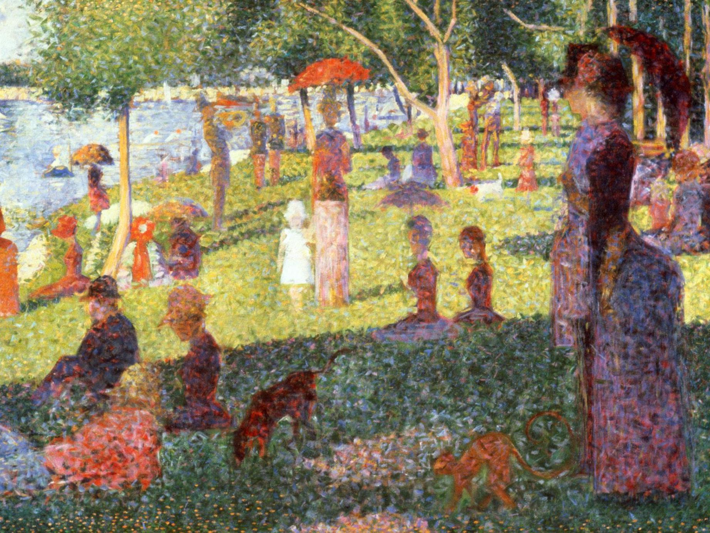
Introduction
Content describes the concepts depicted in the image, such as objects, people, or locations.
Style describes the visual appearance of the artwork, including its color, composition, and shape.
→ The combination of content and artist's individual style makes artwork unique.
Notes:
Let’s start with the foundation of our work: In art analysis, there are two fundamental elements: content and style. Content describes …

Slide 3
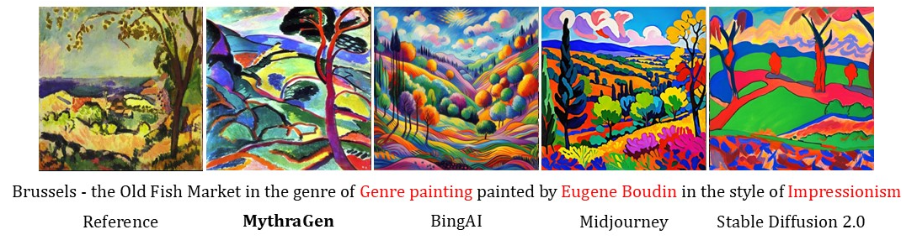
Introduction
Recent advances in Text-to-Image (T2I) models have been impressive but faces challenges:
Struggles with rare genres or styles.
Often generates popular or non-existent styles that miss user intents.
Techniques like Dreambooth, Textual Inversion, and LoRA help but have issues:
Require some sample images for fine-tuning.
High costs to fine-tune models for diverse artist styles.
Notes:
Althougth recent advances in Text-to-Image (T2I) models have been impressive, they struggle with rare genres and often produce overly popularized or even non-existent styles. There are some technique like .... address this but they have some issues, when we use, we need to provide some sample image that has the style we want to fine tune model and
One artist can paint in many different styles.
When extending this to hundreds of artists, the need to fine-tune or retrain the model for each artist's style becomes impractical. This process requires a vast amount of computational resources and time, making these methods unrealistic for large-scale application.

Slide 4
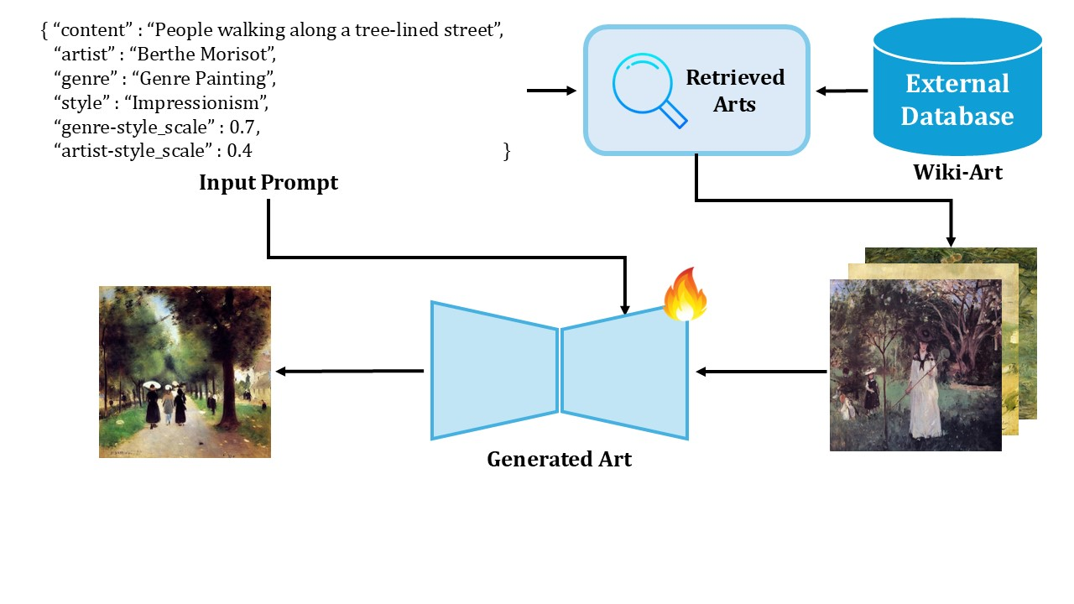
Overview of MythraGen
MythraGen addresses T2I limitations with two components:
Art Retrieval - searches an external database for relevant images based on the user prompt.
Art Generation - uses these retrieved images to refine and generate outputs that closely match the user’s input
Notes:
To address these issues, we propose MythraGen, a simple efficient retrieval augmented art generation framework. It contains two component. The first one is art Retrieval, which searches an external database for relevant images that have the highest similarity in content, genre, and style to the artist described in the prompt. Art Generation that refines and generates outputs that closely match the user’s input.

Slide 5
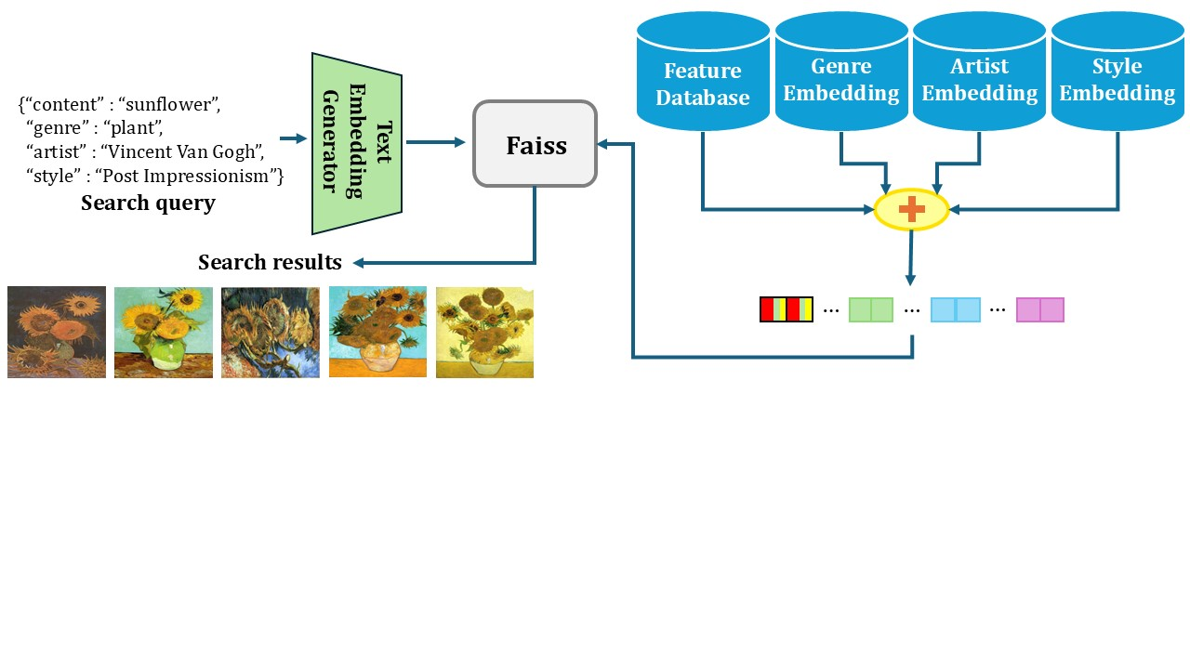
Art Retrieval
Overview
Combines embeddings (feature, genre, artist, style) into a 1024-dimensional vector, with Feature Embedding using specific weighting schemes.
Indexes the embeddings using FAISS for efficient retrieval.
Processes queries with the Text Embedding Generator to find images matching the prompt in content, genre, and style.
Notes:
Let’s look at the Art Retrieval process. It combines embeddings (feature, genre, artist, style) into a 1024-dimensional vector, with Feature Embedding using specific weighting schemes. These vectors are indexed with FAISS for efficient retrieval. And when the input query is provided, it will be processed with the Text Embedding Generator to find images matching the prompt in content, genre, and style.

Slide 6
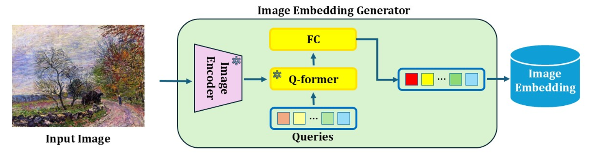
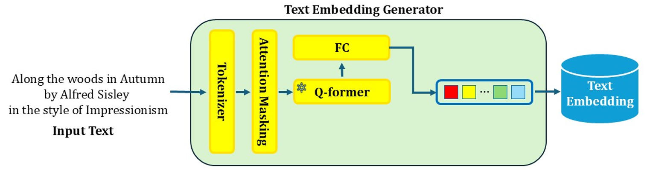
Art Retrieval
Vector Embedding
Image Embedding Generator: Extracts visual features using a pre-trained image encoder, combines them with query tokens, and processes them through the Q-Former (BLIP-2)
Text Embedding Generator: Tokenizes input text, processes it through the Q-Former (BLIP-2), and normalizes outputs to create the final text feature vector.
Notes:
To create these embeddings, we utilize two generators: Image Embedding Generator and Text Embedding Generator. Image Embedding Generator that extracts visual features from a pre-trained encoder, processes them with query tokens through the Q-Former, and produces a final normalized vector. And Text Embedding Generator that tokenizes and processes the input text through the same Q-Former and normalizes outputs to create the final text feature vector. This process ensures precise alignment between text and image features.

Slide 7
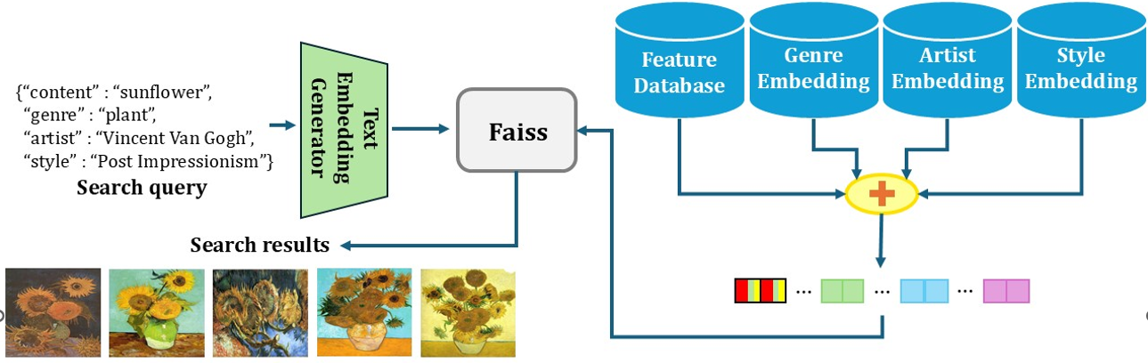
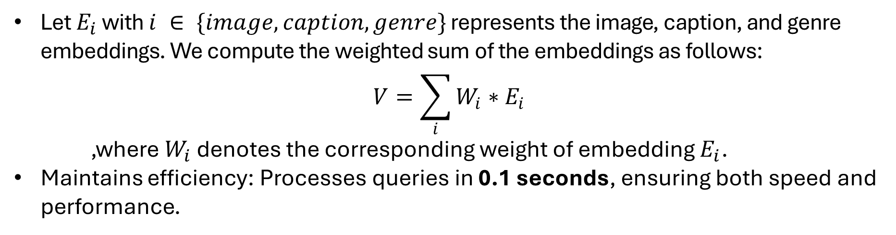
Art Retrieval
Feature Embedding
Let $E_{i}$ with $i ∈ \{image, caption, genre\}$ represents the image, caption, and genre embeddings. We compute the weighted sum of the embeddings as follows:
$$V=\sum_{i}{W_{i}∗E_{i}}$$
,where $W_{i}$ denotes the corresponding weight of embedding $E_{i}$.
Maintains efficiency: Processes queries in 0.1 seconds, ensuring both speed and performance.
Notes:
To optimize retrieval, we combine image, caption, and genre embeddings into a feature embedding using a weighted sum formula here. The resulting vector V becomes the final feature vector used for retrieval content and genre.
Despite this added complexity, the system maintains high efficiency, processing queries in just 0.1 seconds.
However, the feature vector may not perform well in retrieving style and artist information because it mainly captures the content and genre. Moreover, many art styles share significant similarities in technique, such as Action Painting and Abstract Expressionism, or between like Impressionism and Post-Impressionism. This makes it difficult to distinguish between closely related styles or specific artists. To address this, we concatenate additional style embedding and artist embedding to enrich the data for the vector before the indexing phase. You can see in the image here.

Slide 8
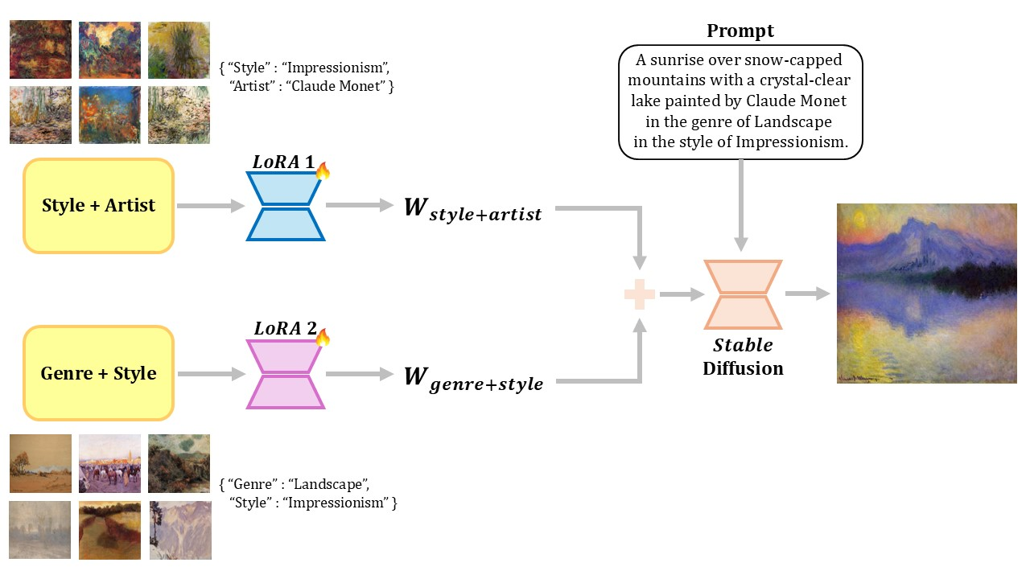
Art Generation
The Art Generation module using LoRA technique to fine-tune Stable Diffusion models on data retrieved by Art Retrieval.
Process:
Fine-tunes two distinct LoRA for genre, style, and artist characteristics.
Combines outputs of these models, weighted for balance, to generate target images.
Notes:
Let's move to the Art Generation module utilizes LoRA technique to fine-tune Stable Diffusion models. In our work, We fine-tuning two distinct LoRA: one for genre and style and one for style and artist. After fine-tuning, These weighted models are then mixed together, in conjunction with the given prompt, to generate the final target image. For example, combining the Landscape genre, Impressionism style, and Claude Monet artist can produce a impress image that match the user intents

Slide 9
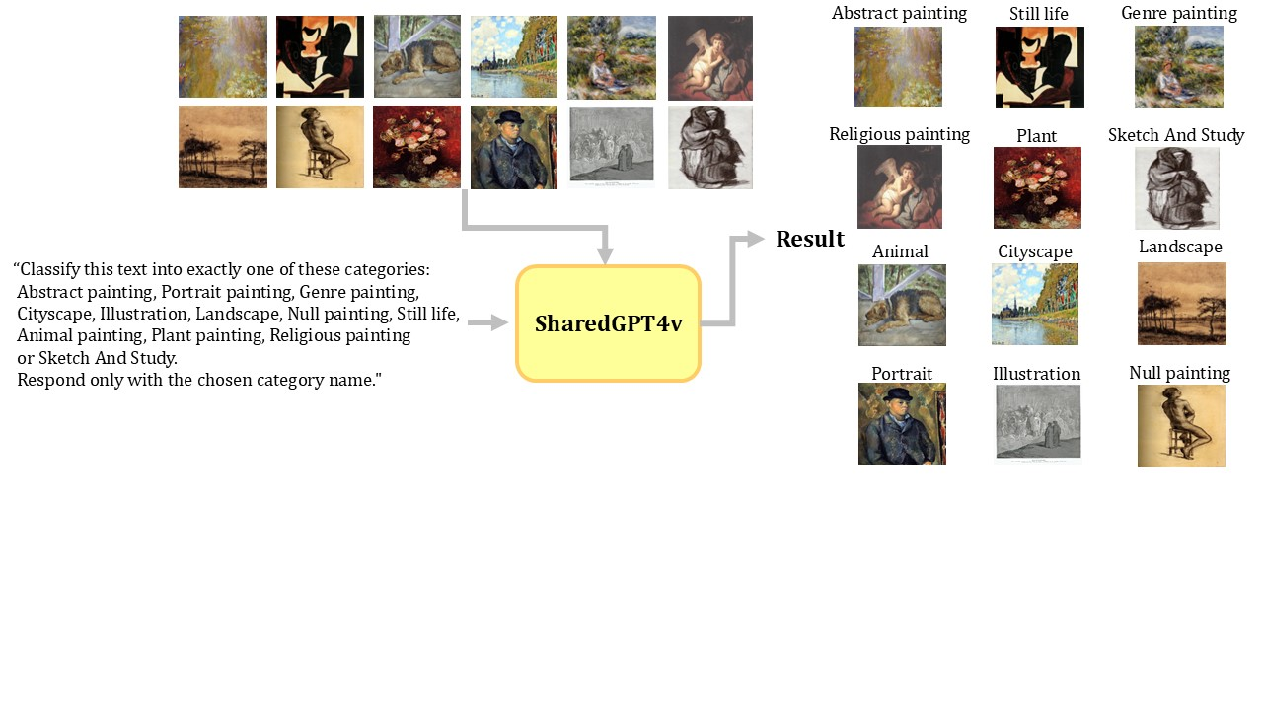
WikiArt dataset
The WikiArt database was used as the external source for all experiments in this paper.
Labeling Challenge: 16,452 images are missing genre labels.
→ A Visual Question Answering (VQA) model, ShareGPT4V, was used to assign these images to one of 12 genres (e.g., genre painting, illustration, landscape).
Notes:
We used WikiArt as the external database for all experiments in this paper. WikiArt has complete labels for artists and styles, but over 16,452 images are missing genre labels. Therefore, we employed a Visual Question Answering (VQA) model (i.e., ShareGPT4V to label these around sixteen thousand images according to 12 corresponding genres (genre painting, illustration, landscape, etc.) as you can see in the image.

Slide 10
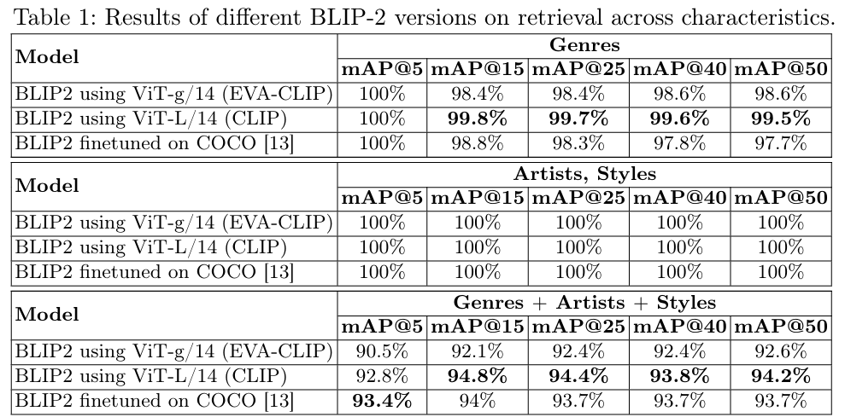
Experiment
Art Retrieval
Notes:
Table 1 shows that all BLIP-2 models achieve perfect mAP@5 of 100 percent, indicating high accuracy. For genres, BLIP-2 with ViT-L outperforms the others with the highest mAP@50 at ninety nine point five percent. In artist and style retrieval, all models achieve perfect mAP@ 100 percent. When combining genre, artist, and style, the COCO-finetuned model leads with the highest mAP@5 of ninety three point 4 percent, but ViT-L/14 (CLIP) excels in more complex tasks, achieving the highest mAP@50 at ninety four point two percent. Overall, ViT-L outperforms in complex queries.

Slide 11
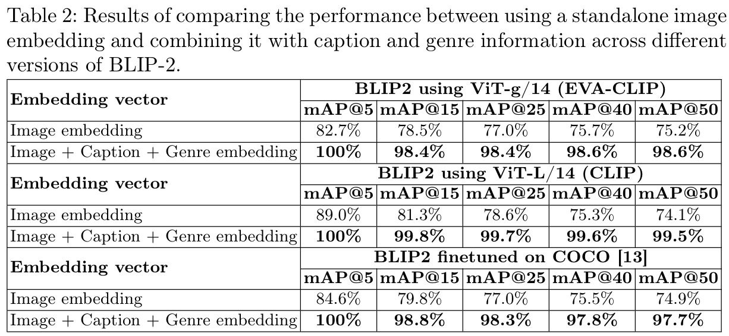
Experiment
Art Retrieval
Notes:
Table 2 shows that using only image embedding gives good results, with ViT-G achieving eighty two point seven percent and ViT-L eighty nine percent at mAP@5. However, adding caption and genre embeddings significantly outperforms, improving accuracy to over ninety eight percent in most cases.

Slide 12
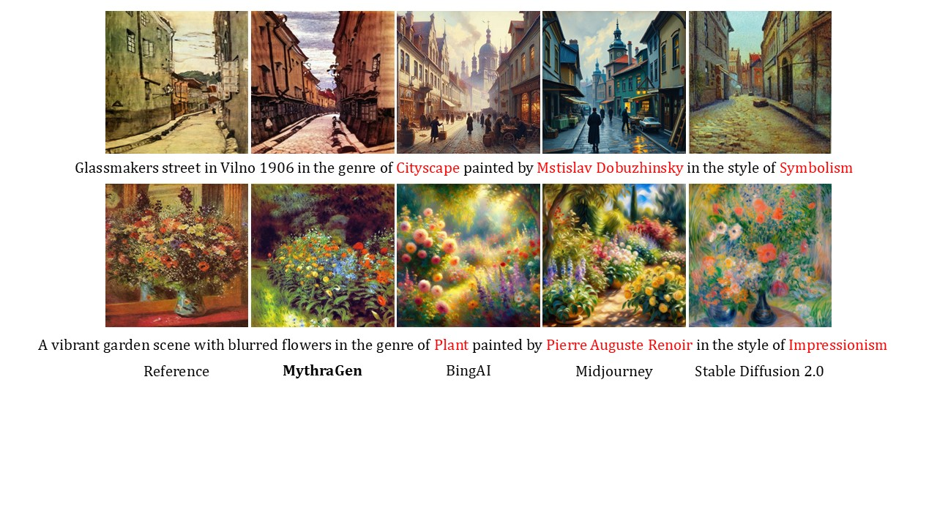
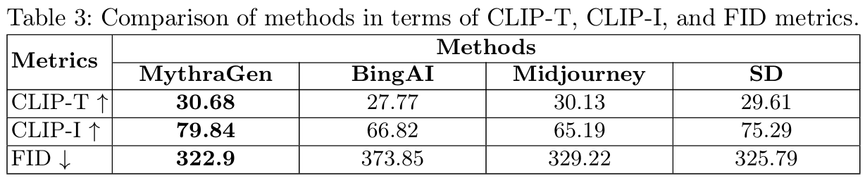
Experiment
Art Generation
Notes:
For experiment of art generation, We compared our method with state-of-the-art (SOTA) methods, including Stable Diffusion (SD) version 2, BingAI and Midjourney.
The comparison was conducted on a customized dataset extracted from WikiArt.
The dataset consists of 50 randomly selected (genre, artist, style) combinations from WikiArt, along with 50 prompts based on scenes that we generated.
Table 3 shows that MythraGen outperforms all other methods across all metrics.

Slide 13
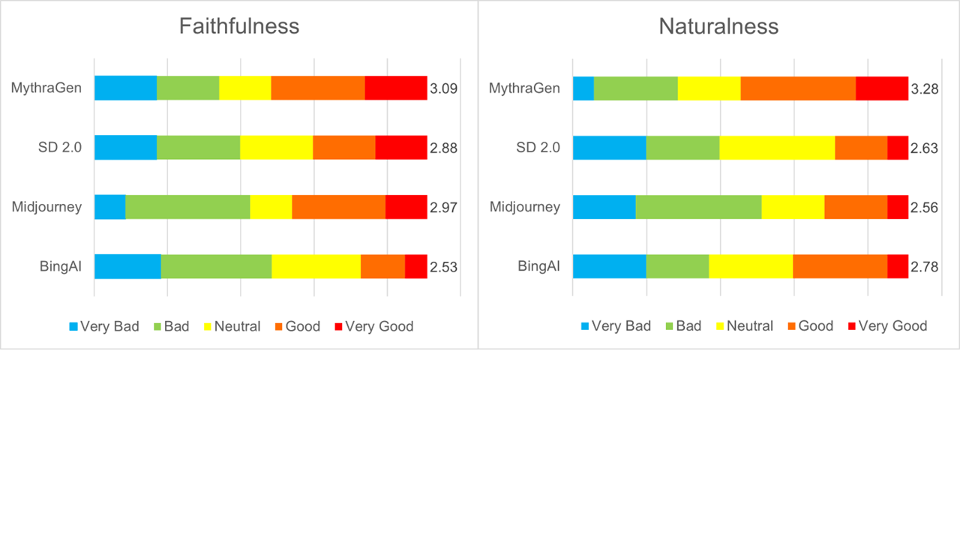
Human Evaluation
Notes:
The figure shows that MythraGen outperforms all other methods in human evaluation. It achieves the highest score for faithfulness with 3.09. For naturalness, MythraGen also leads with 3.28, indicating its images are more visually appealing and better aligned with the described styles. These results highlight MythraGen's superior performance in both accuracy and quality compared to other methods.

Slide 14
Conclusion
MythraGen combines retrieval-based techniques with LoRA fine-tuning to advance text-to-artistic image generation.
Enhances quality and contextual accuracy of generated artworks, meeting diverse artistic style requirements.
Outperforms existing methods in faithfully reflecting text descriptions and producing natural images.
Demonstrates strong results across diverse genres and artistic periods, inspiring further innovation in AI and art.

Slide 15
Thank you
Quang-Khai Le, Cong-Long Nguyen, Minh-Triet Tran, and Trung-Nghia Le​

